Slide 1
TensorFlow Windows Installation
Updated 3 Apr 17
Eric Wespi

Slide 2
Summary
TensorFlow is supported for Windows
To install TensorFlow, we must also install Python
The latest TensorFlow release (1.0.x) is not supported for the latest Python version (3.6)
This presentation will review the Python installation, setting up a Python 3.5 environment, and installing TensorFlow in that environment

Slide 3

Step 1: Install Anaconda (20 min)
Anaconda is a distribution of Python
Anaconda includes Python, some code editors (Spyder and Jupyter Notebooks), the conda package and environment manager, and ~100 commonly used Python packages for data science
Download: https://www.continuum.io/downloads
Install the latest version by clicking the green button

Slide 4
Anaconda Environments
Environments allow for installing multiple versions of Python or Python packages to prevent compatibility issues.
Anaconda environments are controlled via the command prompt primarily with the following basic commands:
Create: build an environment
Activate: activate an environment (make it the current working environment)
Deactivate: go back to the primary environment
Remove: remove an environment, uninstalling its specific software
Info: get a list of the currently installed environments
You can read more about environments here: https://conda.io/docs/using/envs.html#
We will be building a Python 3.5 environment and installing TensorFlow in that environment

Slide 5
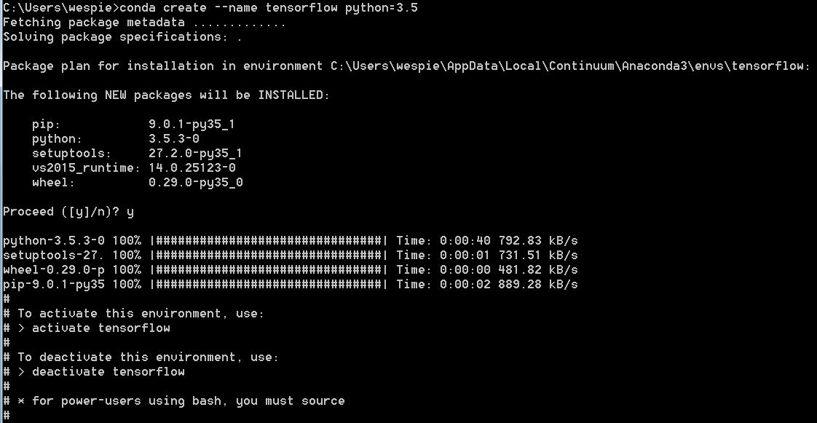
Step 2: Create Environment (10 min)
Open the command prompt and enter the following command:
Enter y to proceed with the installation
This will create an environment named tensorflow, and install Python 3.5.
Note that this will NOT install tensorflow, this is just the name of the conda environment
conda create --name tensorflow python=3.5

Slide 6
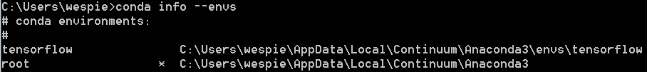

Step 3: Verify and Activate Environment (1 min)
Check to make sure the environment was created properly:
Activate the environment:
The command prompt will change to indicate the current environment
conda info --envs
activate tensorflow

Slide 7
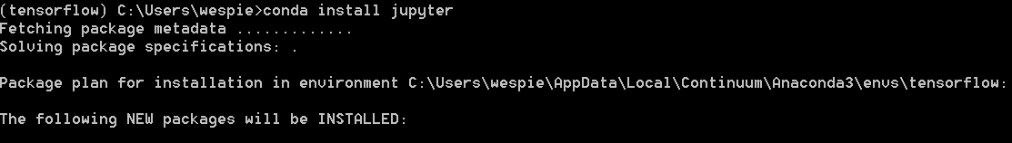
Step 4: Install Jupyter (10 min)
Enter the following command:
This will install the jupyter notebooks software and related packages within the new environment, making it easier to write and execute scripts
The screenshot is cropped- there are several packages to install and it may appear to “hang” at times during the installation. Be patient and wait for the next command prompt
conda install jupyter

Slide 8
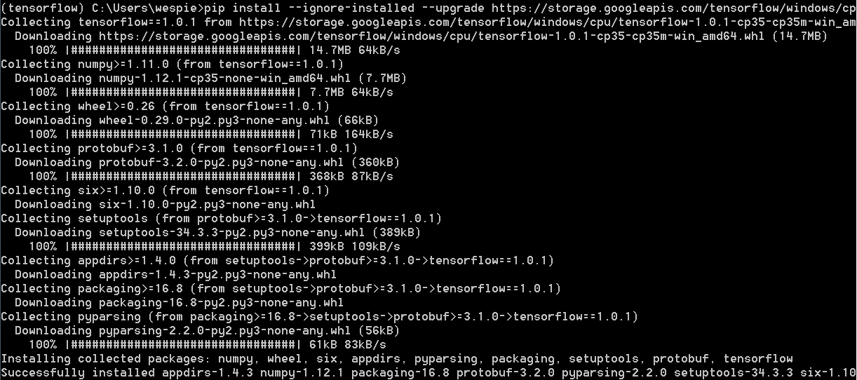
Step 5: Install TensorFlow (5 min)
Copy the following command to the clipboard and paste using right click in the command prompt window:
This will download and install tensorflow, along with the packages it depends on
pip install --ignore-installed --upgrade https://storage.googleapis.com/tensorflow/windows/cpu/tensorflow-1.0.1-cp35-cp35m-win_amd64.whl

Slide 9
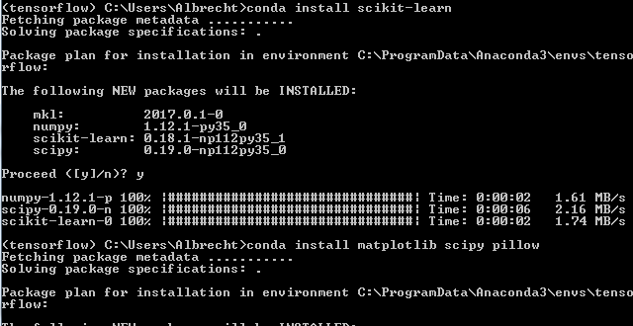
Step 6: Install Utilities (5 min)
Copy the following commands to the clipboard and paste using right click in the command prompt window:
This will download and install additional python utilities
conda install scikit-learn
conda install jupyter matplotlib scipy pillow

Slide 10
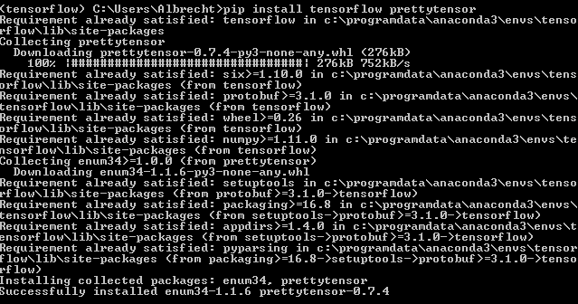
Step 7: Install PrettyTensor (5 min)
Copy the following commands to the clipboard and paste using right click in the command prompt window:
This will download and install prettytensor, which is a lightweight tensorflow wrapper developed by google to simplify the code required for neural network creation and modification in python
pip install tensorflow prettytensor

Slide 11
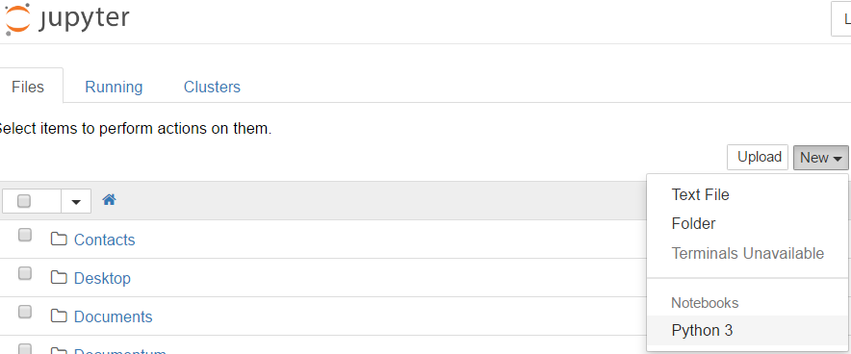
Step 8: Start a Notebook (1 min)
Enter the following command:
This will start a notebook server and should open a browser window
If you need to stop the server and exit, you can type ctrl+c twice
Click on the “New” dropdown menu in the upper right and select Python 3 to create a new notebook:
jupyter notebook

Slide 12


Verify TensorFlow Installation (1 min)
Try to import tensorflow using the line below. Shift+Enter to run the line:
This is the python import statement for the tensorflow package.
An asterisk will appear in place of the line number while the package is importing.
Once it returns to a line number the package is imported.
If there are no errors, congratulations! You’ve successfully installed Python 3.5 and TensorFlow!

Slide 13
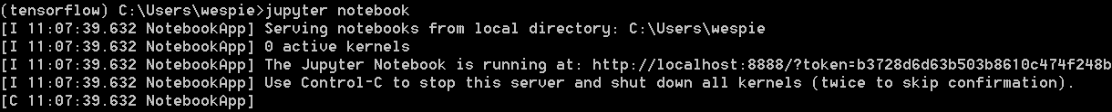

Back Out: Deactivate and Uninstall
To revert to the main environment, you can deactivate the new one
Press ctrl+c twice in the command prompt to stop the notebook server (if running)
Enter the deactivate command:
This will deactivate the environment, but preserve the installation (you can reactivate at any time)
To completely uninstall tensorflow, the associated packages, python 3.5, and remove the environment, enter the remove command:
You can also uninstall Anaconda if necessary via Windows add/remove programs (do the environment remove command first if you are planning on this)
deactivate tensorflow
remove tensorflow

